Slide 1



AutoRestTest
An AI-Powered Platform for Automated REST API Testing
Mohammad Ismail Hossain
Exam Roll: 2322122
BSSE Roll: 1433
Supervised by: Toukir Ahammed

Slide 2

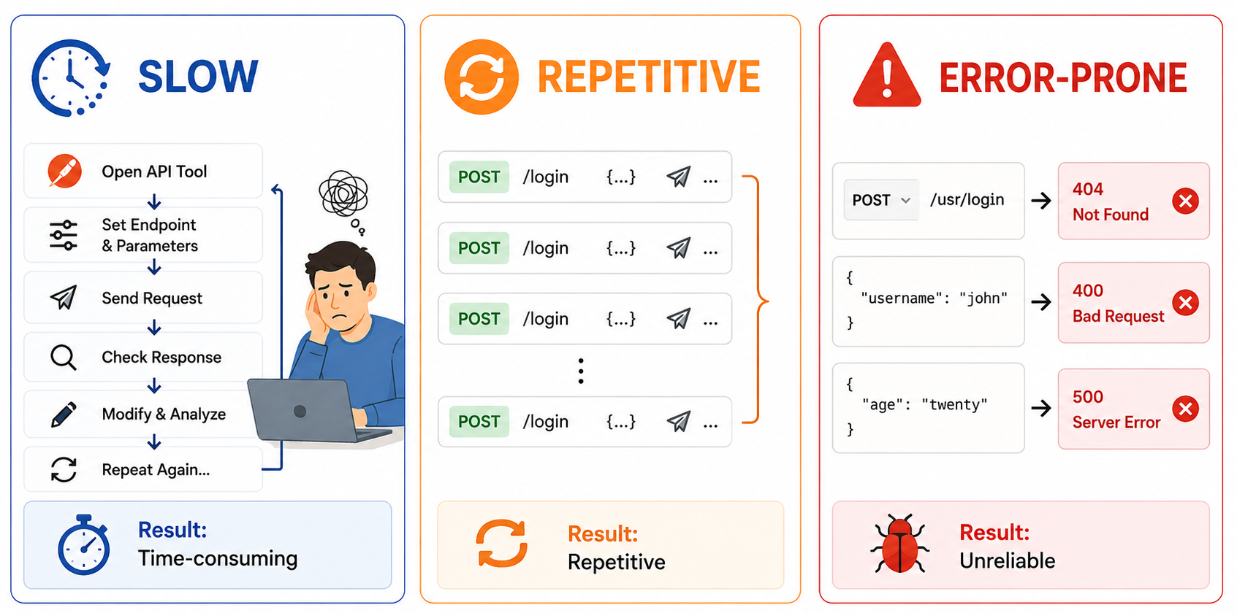
What's wrong with Manual testing?

Slide 3
Project Overview
An AI-powered web platform that turns an OpenAPI specification into a complete, automatically generated and executed REST API test suite.
HOW IT WORKS
1
📄
2
🤖
3
📊
Upload API Spec
System Generate & Run Test
Get Actionable Reports
Import an OpenAPI 3.0 file to define the target API.
Cooperating AI agents explore the API and adapt from every response.
Coverage, status-code breakdown, and detected server errors.
POWERED BY
🎯
Multi-Agent RL
🔗
Semantic Dependency Graph
✨
LLM-Driven Inputs
Agents learn the optimal testing strategy.
Generates realistic, schema-valid values.
Discovers links between API operations.
BUILT WITH
Next.js
NestJS
PostgreSQL
Python
MARL + LLM
1

Slide 4
Functional Requirements - Normal
🔐
📁
📄
User Authentication
Project Management
Specification Upload
sign up, login, account verification, password reset, role-based access
Create and organize API testing projects.
Import an OpenAPI 3.0 spec to define the API.
▶️
📊
🔔
Test Execution
Result Viewing
Completion Notifications
Run AI-generated tests against the target API.
Inspect requests, responses, and outcomes.
Get notified when a test run finishes.

Slide 5
Functional Requirements - Expected
🤖
💾
🕐
Automatic Suite Generation
Save & Reuse Suites
Execution History
Persist test suites to re-run them anytime.
Track every past run for each project.
AI builds test cases directly from the spec.
📈
⬇️
👥
Reports & Analytics
Export Reports
Team Collaboration
Coverage and status-code insights per run.
Download results as a shareable PDF.
Invite members with role-based permissions.

Slide 6
Functional Requirements - Exciting
✨
⚡
🧠
Automated Spec Generation
One-Click End-to-End Testing
AI-Powered Req-Res Explanation
Generate an OpenAPI specification from a codebase using AI.
A single action runs the entire testing pipeline for you.
Plain-language explanations of why a test failed.

Slide 7
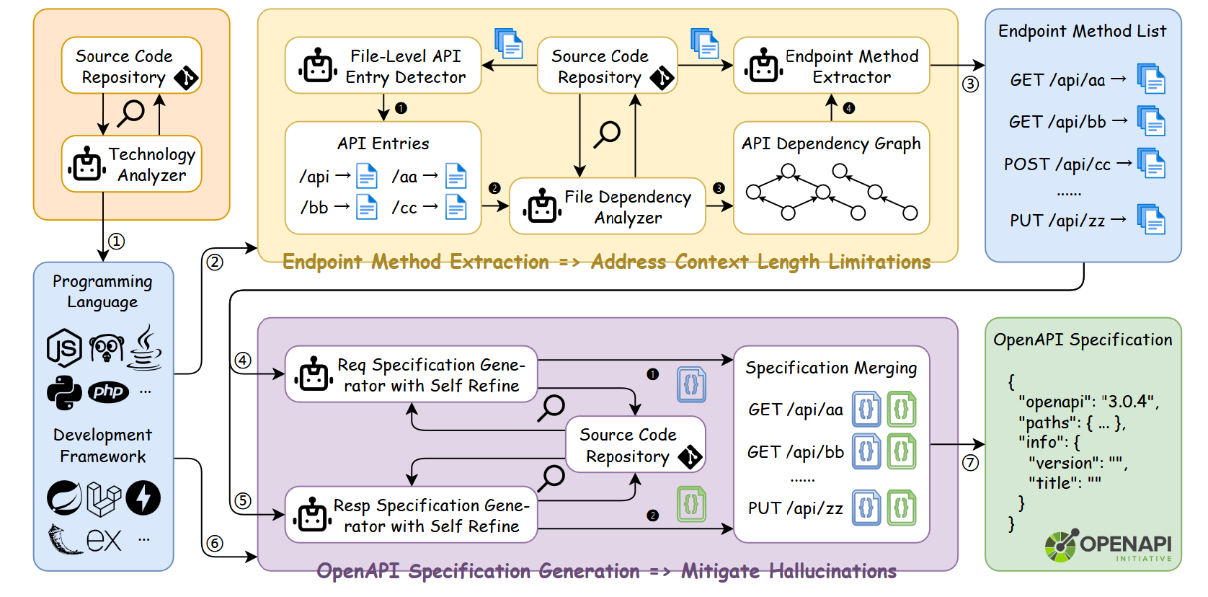
Generating API Spec from Source Code

Slide 8
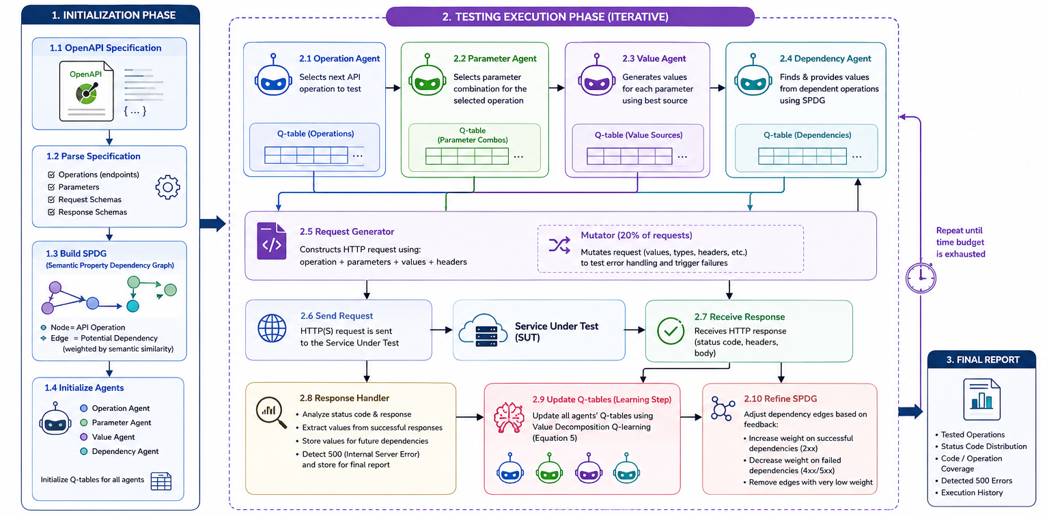
AutoRestTest Testing workflow

Slide 9
Real-World Evaluation

Slide 10
Real-World Evaluation
15
581
88.5%
21,694
396
63
REAL-WORLD APIs
TOTAL ENDPOINTS
AVG. COVERAGE
REQUESTS SENT
SERVER ERRORS (5xx)
FAULTY ENDPOINTS
# | API Project | Endpoints | Endpoint Coverage | Requests | Success (2xx) | Errors (5xx) | Faulty Endpoints
1 | CycleCalcs | 30 | 100% | 1,130 | 501 | 0 | 0
2 | VATcomply | 7 | 100% | 468 | 325 | 0 | 0
3 | Holiday | 6 | 100% | 611 | 361 | 51 | 1
4 | Snipe-IT | 145 | 98% | 3,162 | 2,104 | 6 | 5
5 | CosmyDay | 17 | 94% | 414 | 249 | 0 | 0
6 | ApogeoAPI | 46 | 93% | 496 | 249 | 10 | 3
7 | HomeLogger | 37 | 92% | 2,208 | 1,134 | 94 | 4
8 | UK Parliament Members API | 43 | 91% | 1,306 | 590 | 35 | 1
9 | Laravel Blog | 23 | 91% | 2,250 | 1,235 | 10 | 4
10 | IUCN Red List | 50 | 88% | 894 | 423 | 3 | 3
11 | RealWorld | 17 | 88% | 949 | 230 | 0 | 0
12 | Grocy | 44 | 82% | 1,198 | 414 | 152 | 20
13 | UK Parliament Bills API | 22 | 77% | 4,912 | 1,857 | 2 | 2
14 | CareerStory | 18 | 72% | 680 | 170 | 3 | 1
15 | LubeLogger | 76 | 62% | 1,016 | 314 | 30 | 19
Coverage ≥ 90%
75 – 89%
< 75%

Slide 11
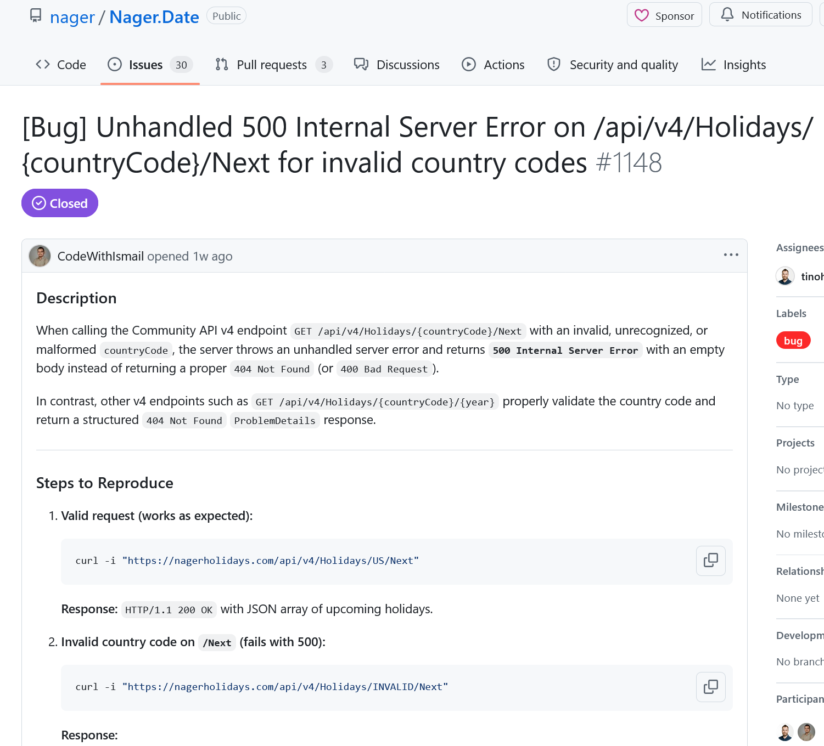
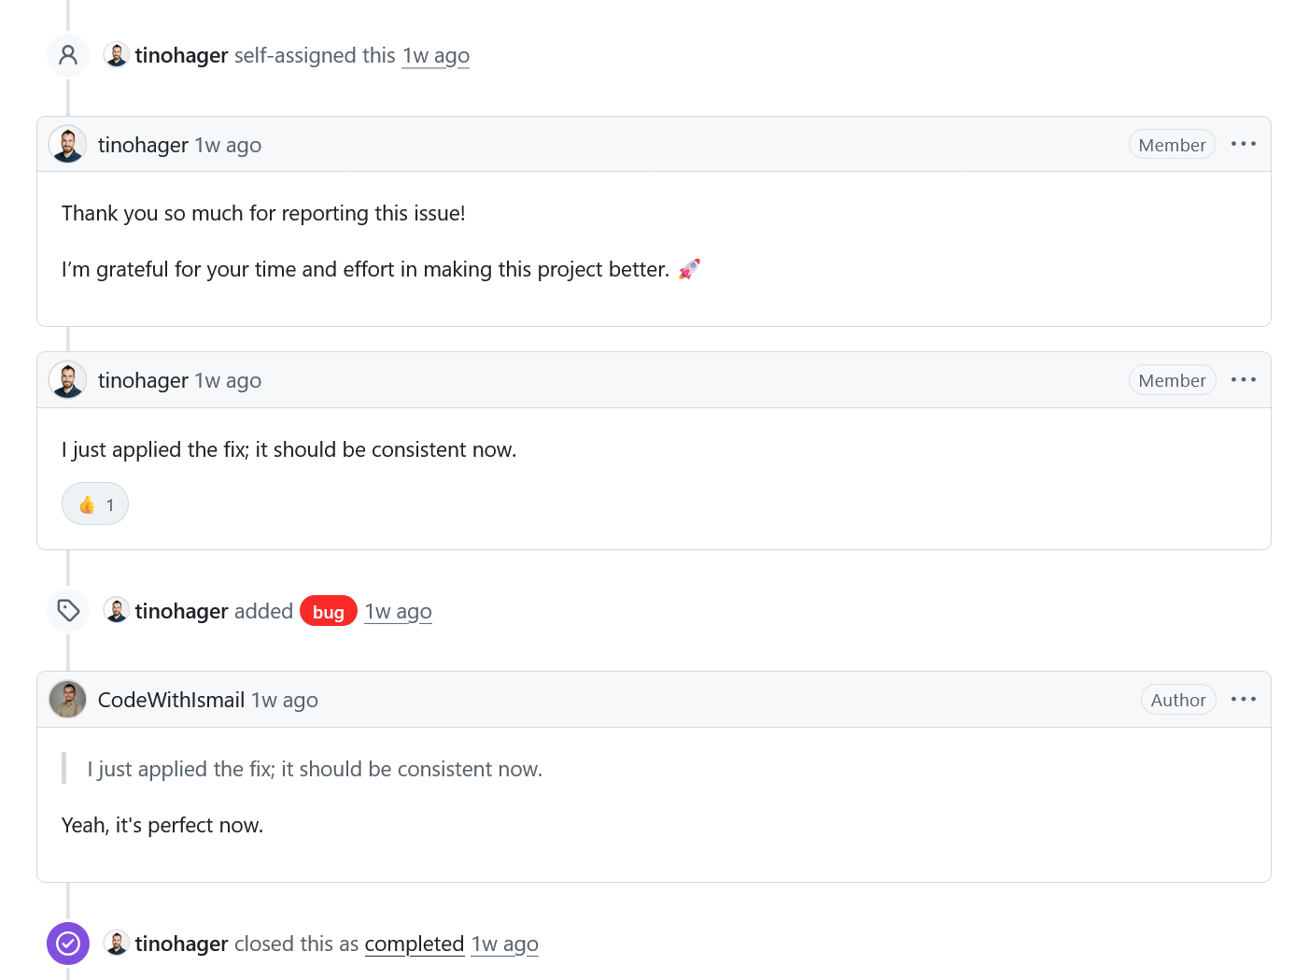
Holiday: github.com/nager/Nager.Date

Slide 12
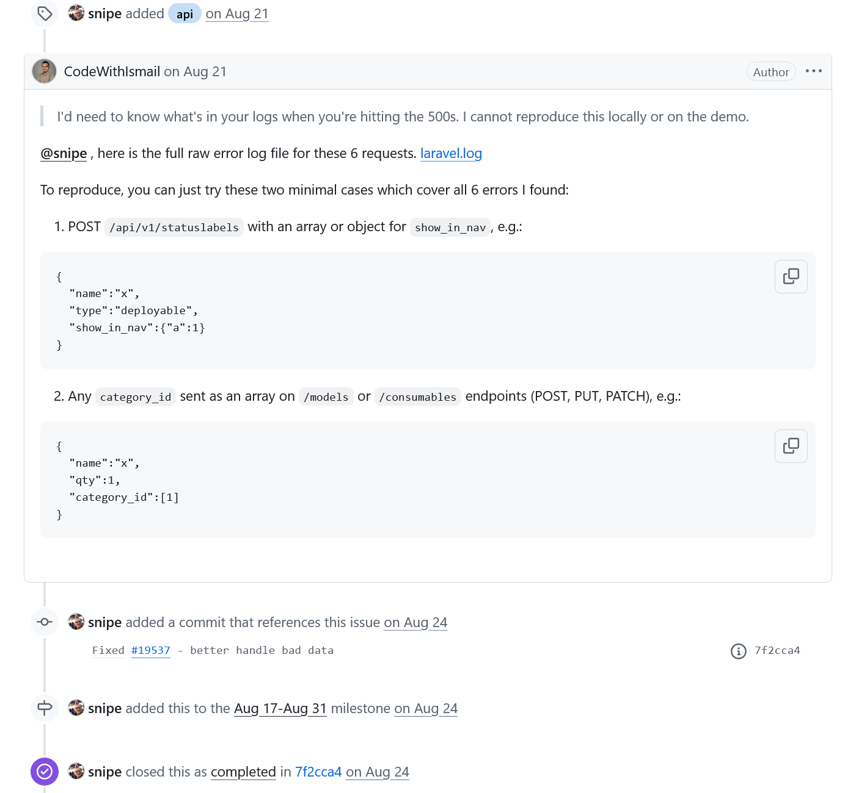
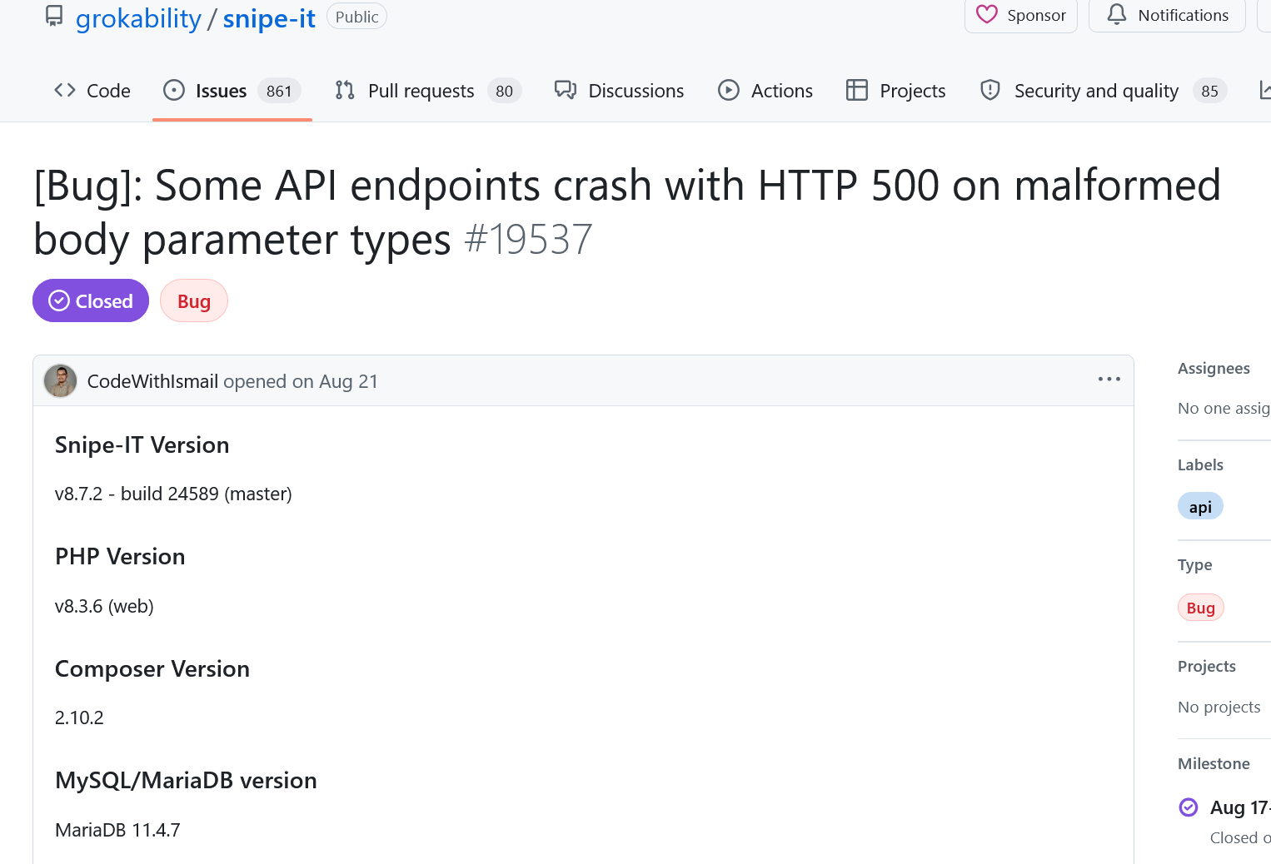
Snipe-IT: github.com/grokability/snipe-it

Slide 13
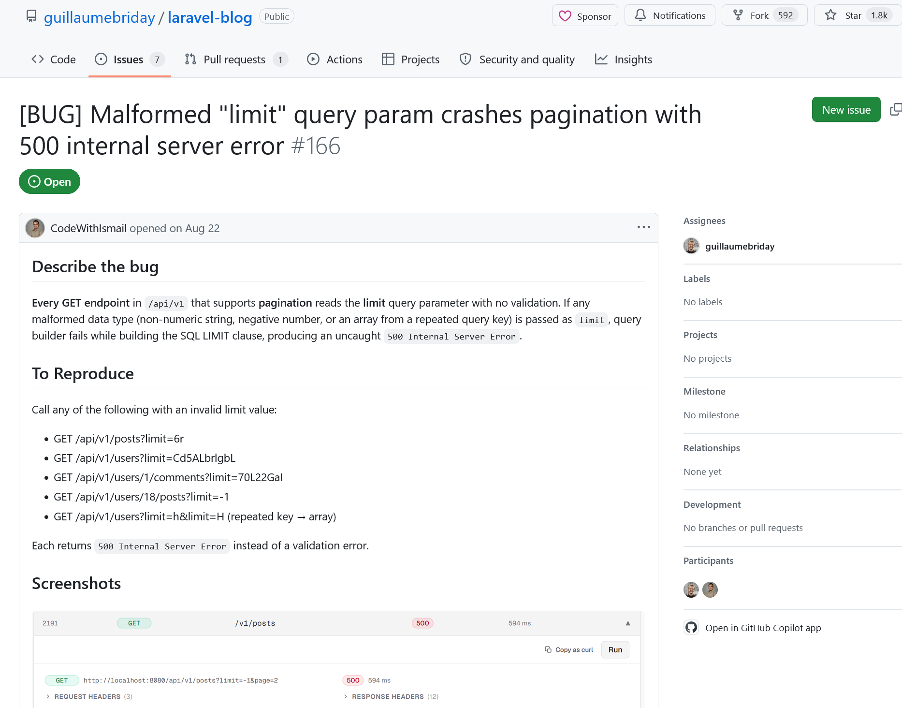
Laravel-blog: github.com/guillaumebriday/laravel-blog

Slide 14
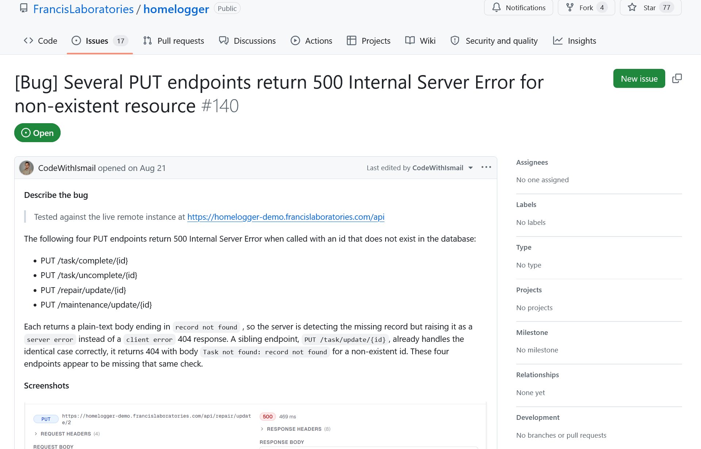
HomeLogger: github.com/FrancisLaboratories/homelogger

Slide 15






Deployment
FRONTEND
BACKEND SERVICE
DATABASE
REST API
SQL
Vercel
Render
Neon DB
REST API
ENGINE SERVICE
LLM PROVIDERS
PUBLIC URL
LIVE
LLM API
autoresttest.vercel.app
Render
NVIDIA NIM
Google Gemini

Slide 16
Demonstration
PUBLIC URL
LIVE
autoresttest.vercel.app

Slide 17
References
Github Repository: https://github.com/CodeWithIsmail/AutoRestTest
Mid Presentation: https://docs.google.com/presentation/d/1a5YdaNx8cxYphxiUQ-I-3NPXjf6xh7-W/edit?usp=sharing&ouid=106339911626160544503&rtpof=true&sd=true
Proposal Presentation:
https://docs.google.com/presentation/d/1J23ATRQ7J8jLjVxXMxO6MJ6h6e8ZmXZn/edit?usp=sharing&ouid=115068811724755054134&rtpof=true&sd=true
AutoRestTest Paper: https://arxiv.org/abs/2411.07098v2
OOPS Paper: https://arxiv.org/abs/2601.12735

